Slide 1
Web and Intranet Search:
What‘s Next After Google* ?
Moderator: Gerhard Weikum (Max-Planck Institute for CS)
Panelists: Eric Brill (Microsoft Research)
Hector Garcia-Molina (Stanford University)
Jan Pedersen (Yahoo!)
Prabhakar Raghavan (Verity)
* as the symbol for Web search engine technology

Slide 2
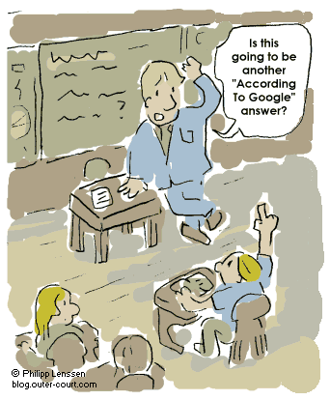
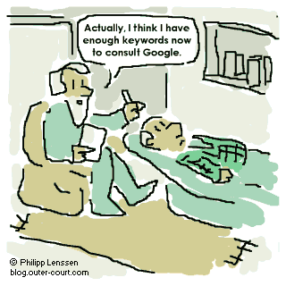
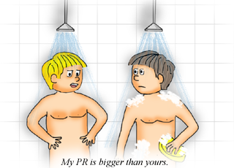
Google is Great
© 2003 Verity Intellectual Properties Pty Ltd
but progress is incremental,
no breakthrough anymore
great for e-shopping, school kids, scientists, doctors, etc.
high-precision results for simple queries
superb scalability (now >8 Bio. docs, >1000 queries/sec)
continuously enhanced: Froogle, Google Scholar, alerts,
multilingual for >100 languages, query auto-completion, etc.

Slide 3
What Google Can‘t Do
Killer queries (disregarding QA, multilingual, multimedia):
drama with three women making a prophecy
to a British nobleman that he will become king

Slide 4
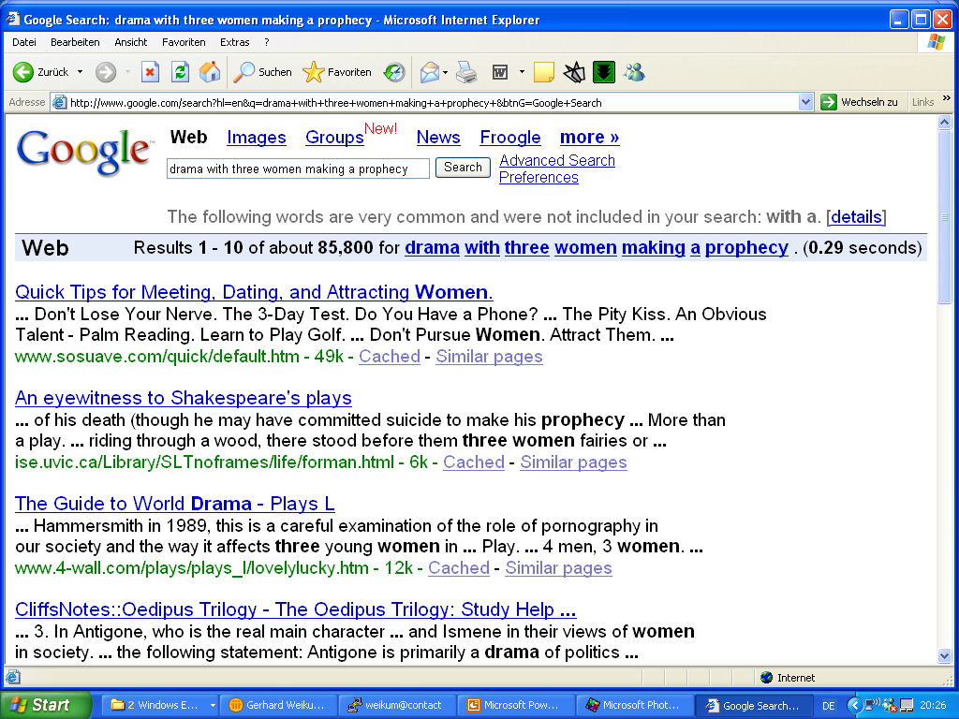

Slide 5
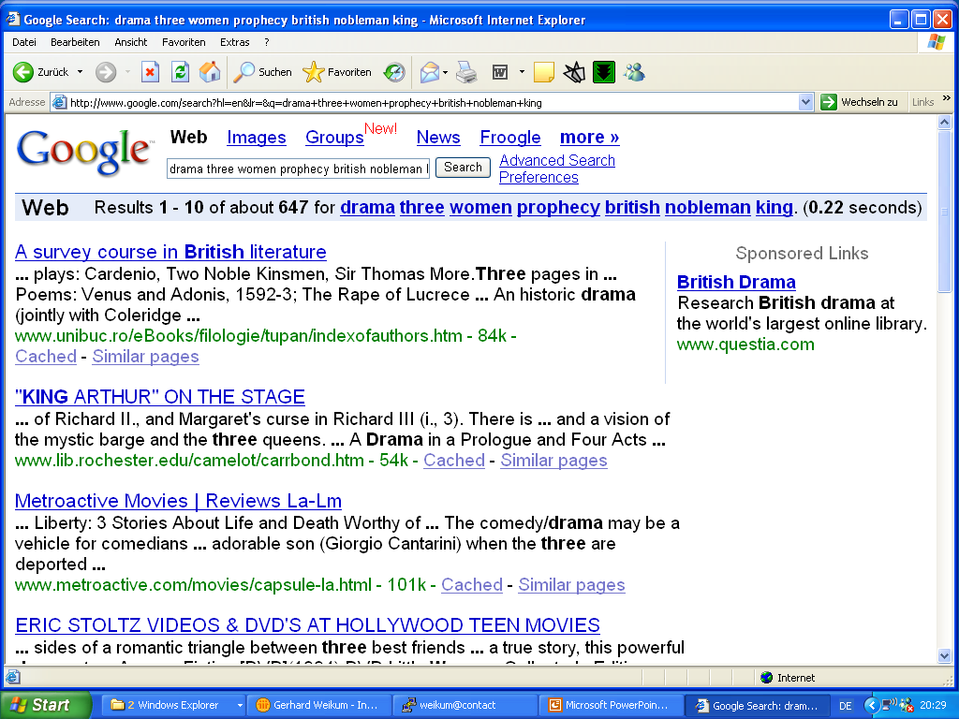

Slide 6
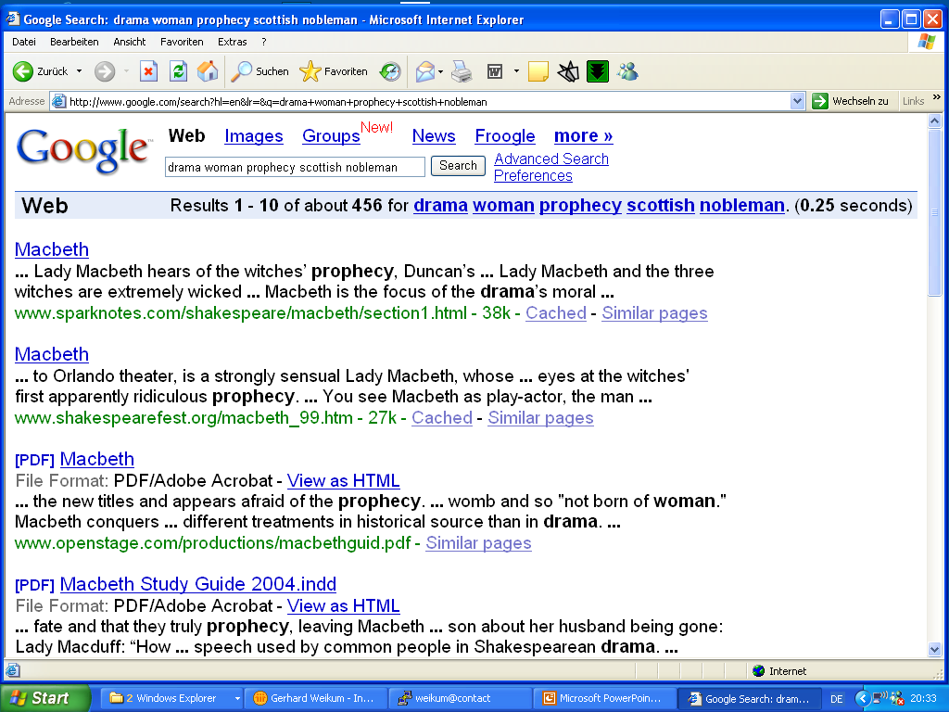

Slide 7
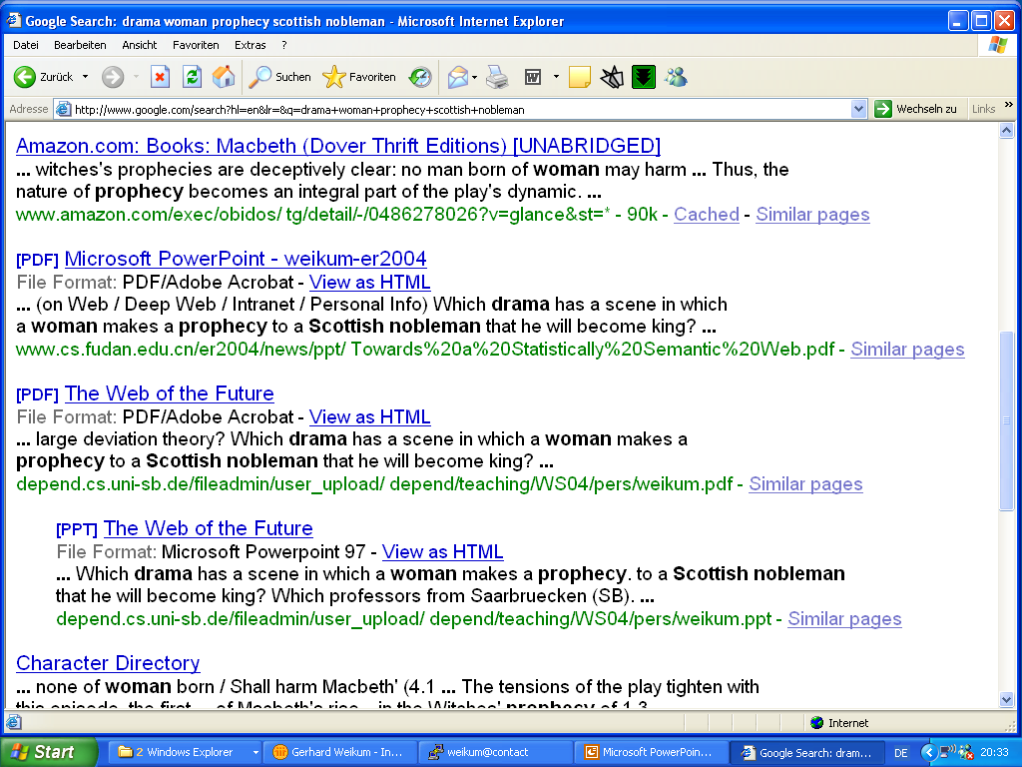

Slide 8
What Google Can‘t Do
Killer queries (disregarding QA, multilingual, multimedia):
drama with three women making a prophecy
to a British nobleman that he will become king
by IT professionals:
peak load of Google
effect of XML on IT industry in 2001
expert in NLP & statistical learning with interest in outdoors
and sense of humor
by computer scientists:
researcher who has worked on OLTP and astronomy
articles that question the feasibility of the Semantic Web
benchmarks on XML information retrieval
by kids:
negative reviews about the book „Lord of the Rings“
next movie with Johnny Depp

Slide 9
Silver Bullets for Web & Intranet Search ?
Aim for quantum-leap improvement in 10-Year timeframe
Marvelous 3-letter acronyms that led to breakthroughs:
SQL, XML, WWW, TCP, LRU, CPU, ETC
NLP: Natural Language Processing, Info Extraction
SML: Statistical Machine Learning for
Classification, Info Extraction, Entity Resolution, etc.
XML: More Structure, Metadata, Annotations
W3C: Semantic Web, Ontologies, Description Logics, etc.
P2P: Collaborative Recommendations & Filtering,
Swarm Intelligence
AUM: Advanced (Cognitive) User Models, Personalization

Slide 10
The Distinguished Panelists
Eric Brill: Senior Researcher, Microsoft Research
head of text mining group; formerly John Hopkins U;
Brill PoS tagger, question answering, disambiguation
Hector Garcia-Molina: Chair, Stanford University
Sigmod Award 1999, 294 DBLP entries, Citeseer rank 27;
Deep-Web search, data integration, WebBase, P2P systems
Jan Pedersen: Chief Scientist, Yahoo! Inc.
formerly Xerox PARC, AltaVista;
automatic classification, thesauri, query-log exploitation
Prabhakar Raghavan: CTO, Verity Inc.
Adjunct Prof Stanford, formerly IBM Almaden; Editor-in-Chief JACM;
XML IR, Web graph & social network analysis, randomized algorithms

Slide 11
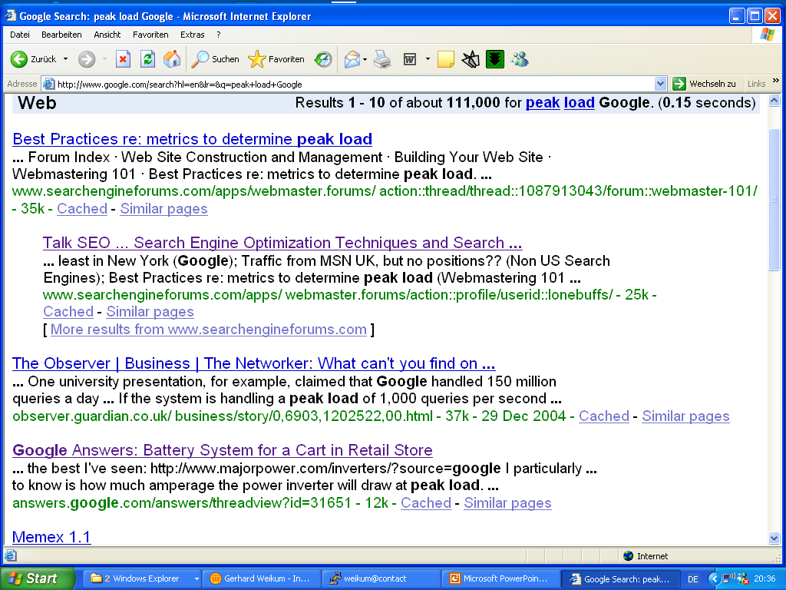

Slide 12
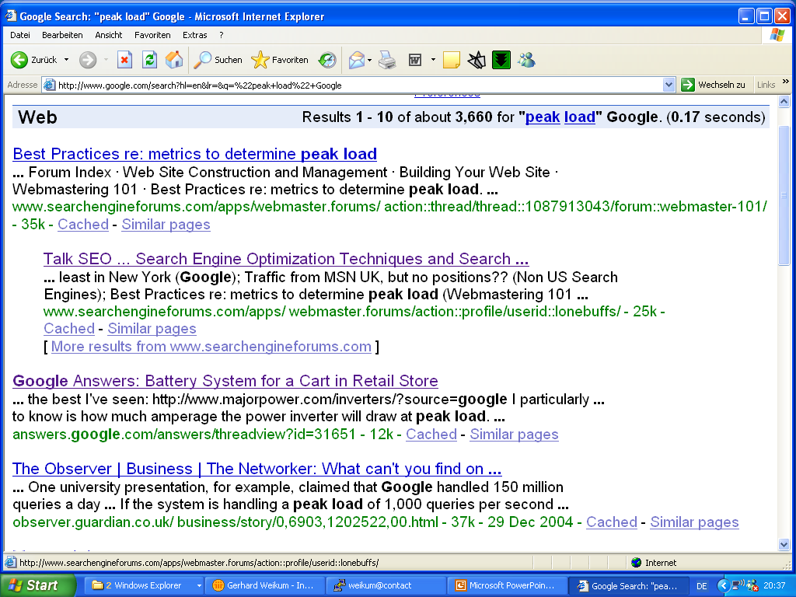

Slide 13
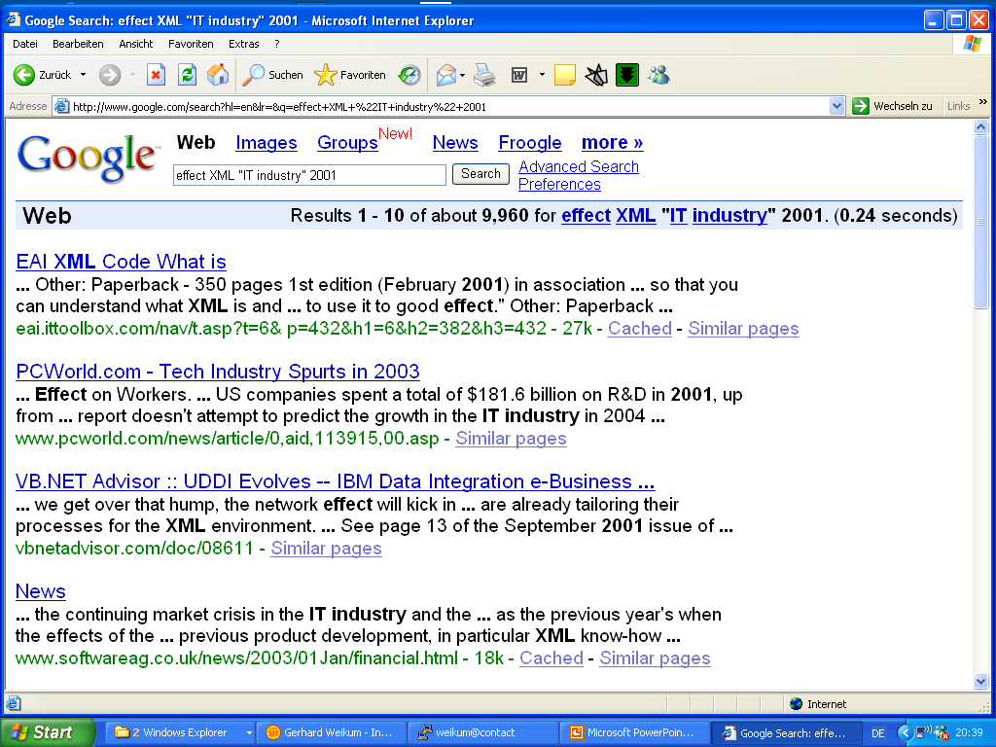

Slide 14
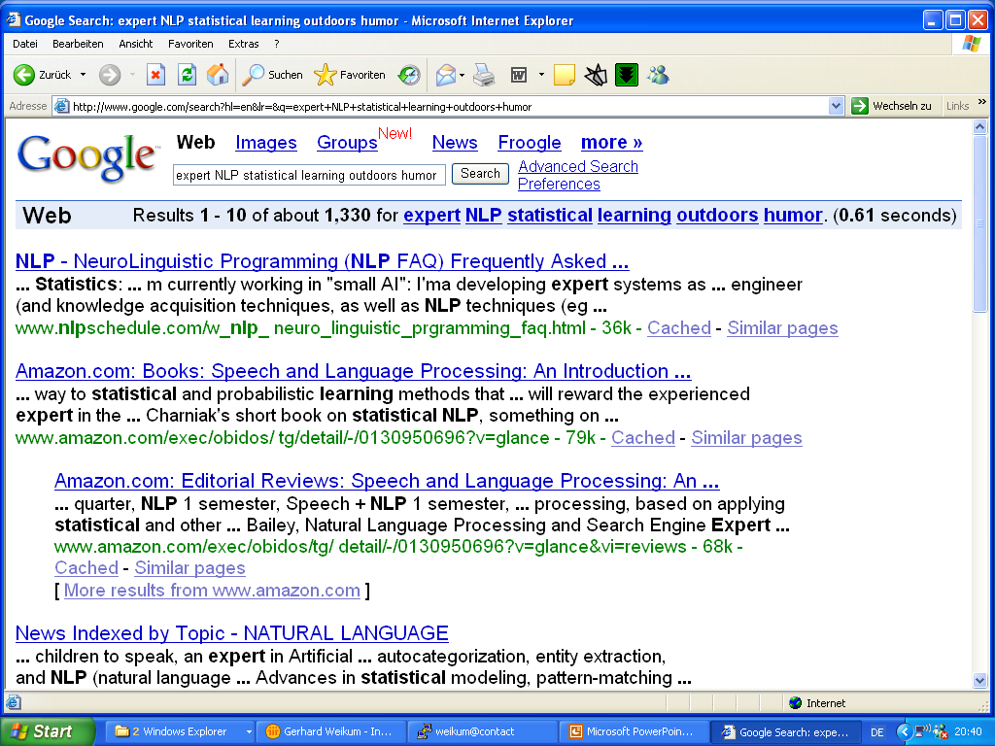

Slide 15
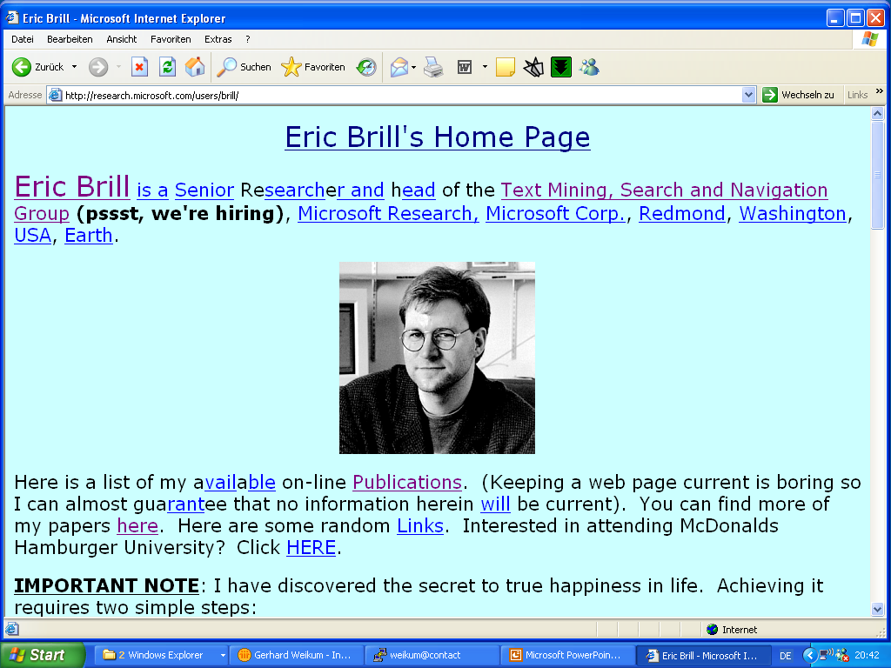

Slide 16
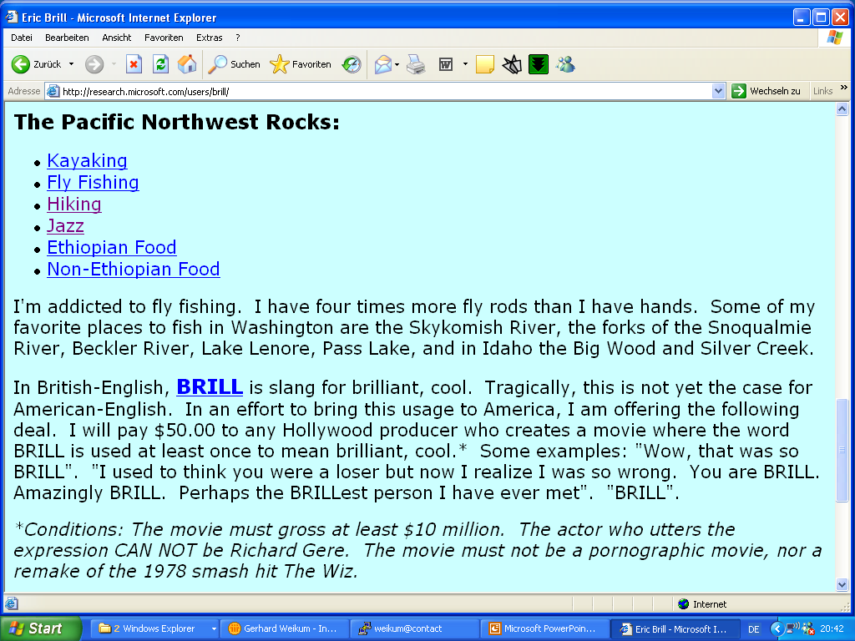

Slide 17
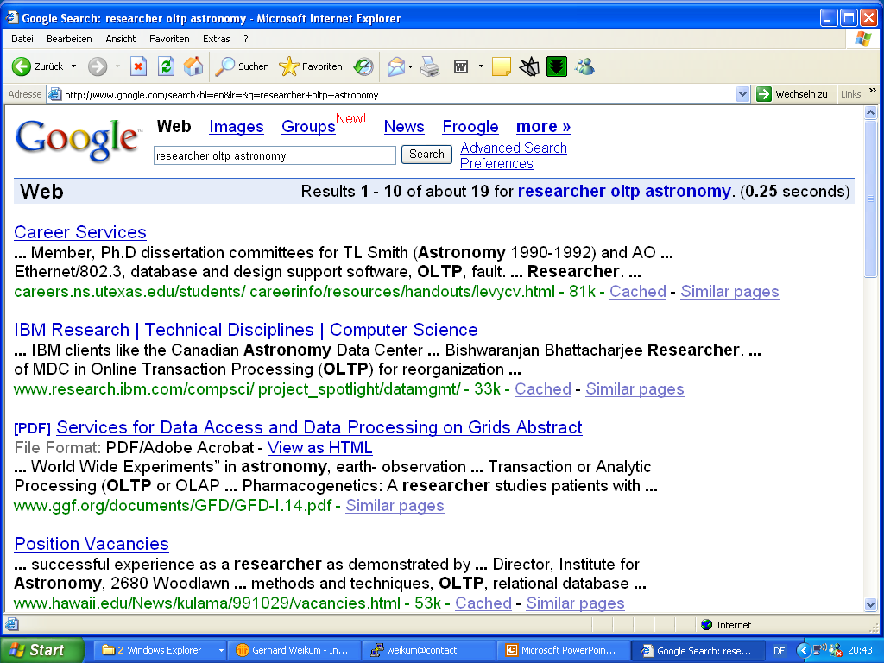

Slide 18
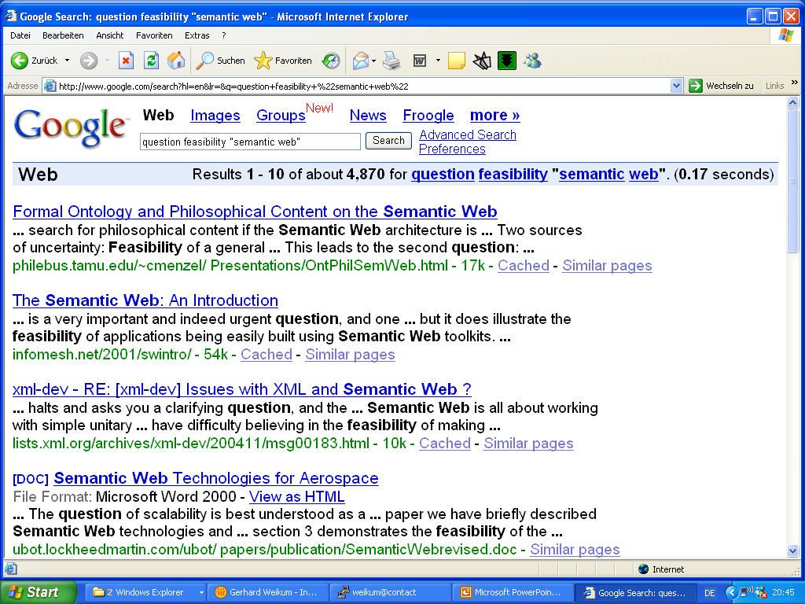

Slide 19
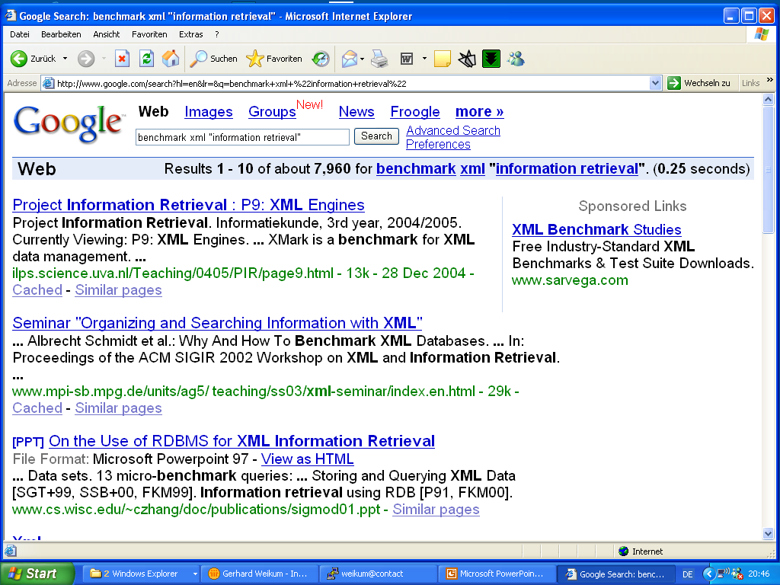

Slide 20
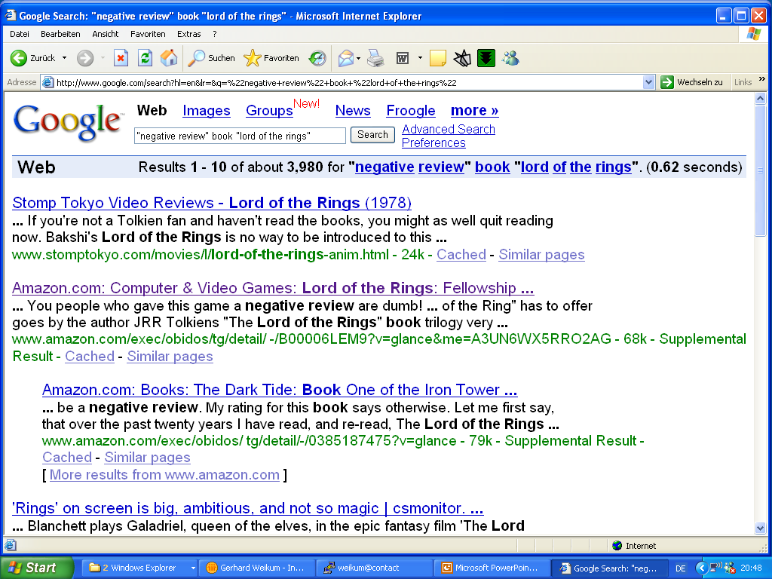

Slide 21
